Slide 1
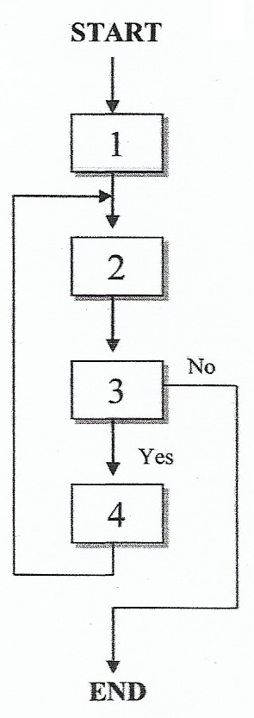
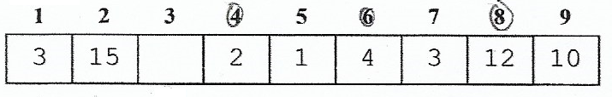
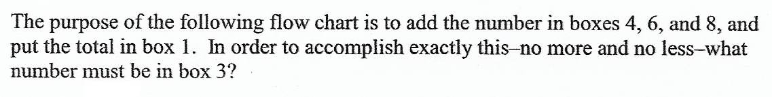
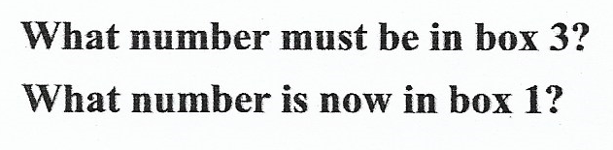

Slide 2
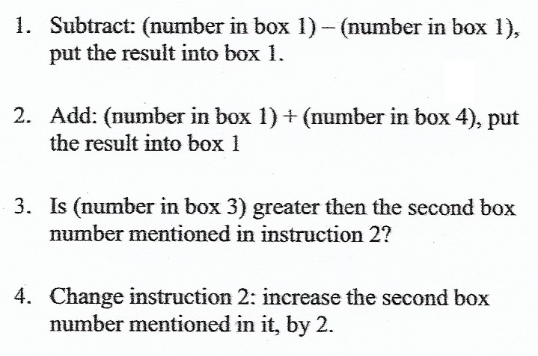

Slide 3
0

Slide 4
0

Slide 5
2

Slide 6
2
Because The Value of Box 6 and 8 haven’t been added to Box 1 yet, the flow have to continue

Slide 7
2
> 4
Because The Value of Box 6 and 8 haven’t been added to Box 1 yet, the flow have to continue

Slide 8
2
> 4

Slide 9
2
> 4
6

Slide 10
2
> 4
6

Slide 11
6
> 4
6

Slide 12
6
> 4
6

Slide 13
6
> 4
6
Because The Value of Box 8 haven’t been added to Box 1 yet, the flow have to continue

Slide 14
6
> 6
6
Because The Value of Box 8 haven’t been added to Box 1 yet, the flow have to continue

Slide 15
6
> 6
6

Slide 16
6
> 6
8

Slide 17
6
> 6
8

Slide 18
18
> 6
8

Slide 19
18
> 6
8

Slide 20
18
> 6
8
The condition is already fulfilled in this stage. So to quit the loop, statement number 3 have to be false

Slide 21
18
> 6
< 8
8
The condition is already fulfilled in this stage. So to quit the loop, statement number 3 have to be false

Slide 22
18
7
8
The condition is already fulfilled in this stage. So to quit the loop, statement number 3 have to be false

Slide 23
18
7
8

